Slide 1
Supercharged brainstorming with Baloonr
Martin

Slide 2
It’s so meta
“It is meta – use a digital service to propose a Digital Service” – Jeremy Alexis

Slide 3
Old style brainstorming
Get everyone together in one place
People suggest as subset of ideas they could because they are shy, they are concerned their ideas silly, they wait to see what the boss suggests, etc.
Discuss what are the best ideas (with the most vocal person often winning as opposed to the best idea winning)

Slide 4
Approaches to brainstorming

Slide 5
Researched backed best brainstorming Approach
Stage 1 – Launch the process to gather ideas
Stage 2 - Brainstorm on your own capturing your ideas
Stage 3 - Add others who build on your ideas and you build on their ideas (e.g. help improve other peoples ideas while they help improve yours)
Stage 4 - Use social voting to let the “democratic process” have the best (or most broadly supported) ideas move to the top

Slide 6
Brainstorming with Baloonr

Slide 7
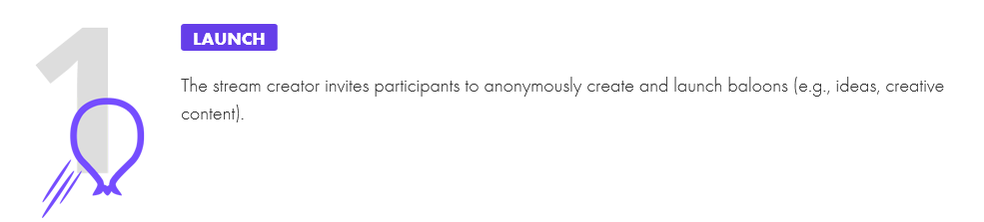
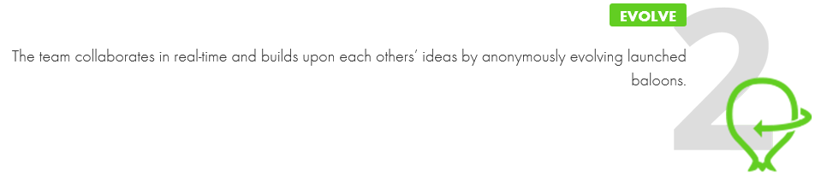
Four Stages to ballonr

Slide 8
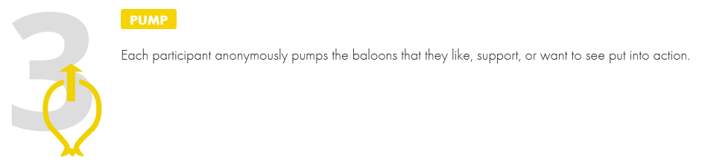
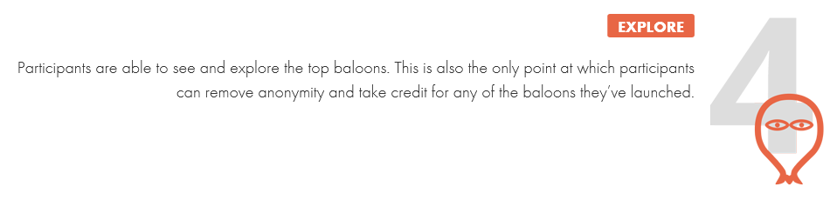
Four Stages to ballonr

Slide 9
Signup for Baloonr

Slide 10
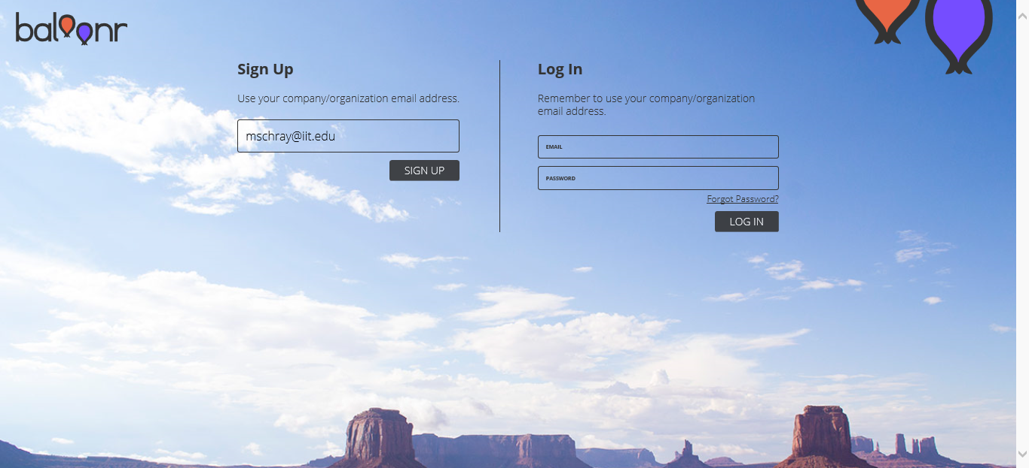
You’ll Signup with your IIT email
Sign up using your IIT email address using the following link https://app.baloonr.com/
youremail@iit.edu

Slide 11
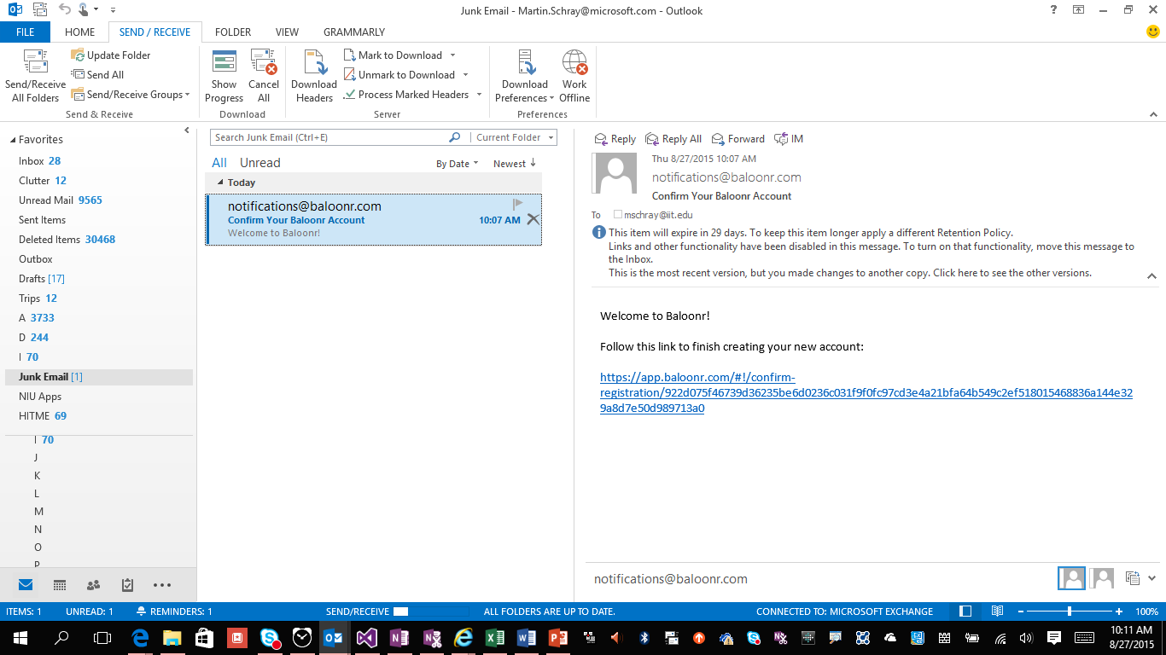
Use the confirmation email

Slide 12
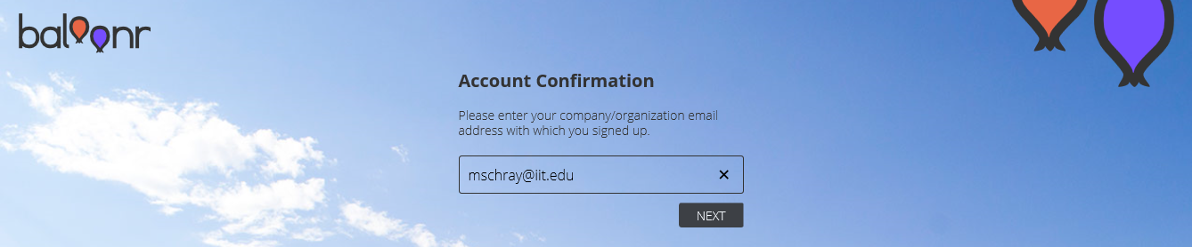
Re-enter email

Slide 13
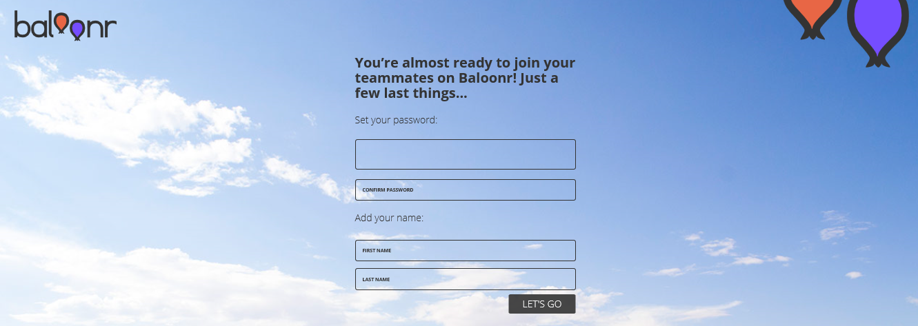
Enter password and Name

Slide 14
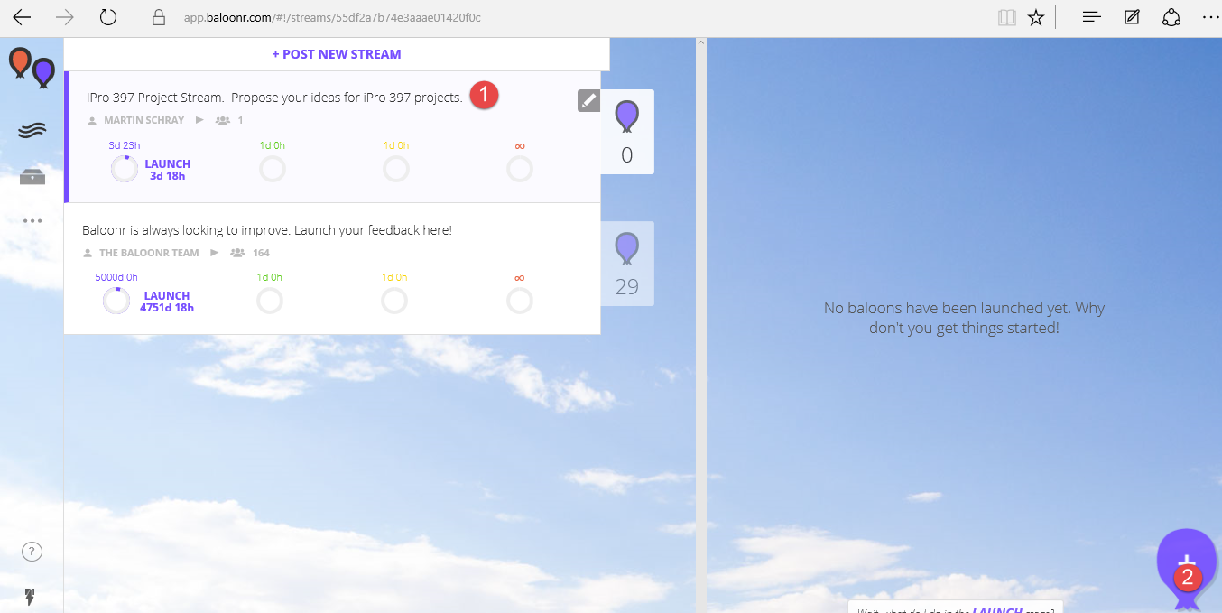
Entering your idea(s) in Baloonr
After registering and logging in there are two steps
Click on the “Ipro 397 project stream
Click on the balloon at the bottom right to enter your idea(s) for ipro projects

